Slide 1
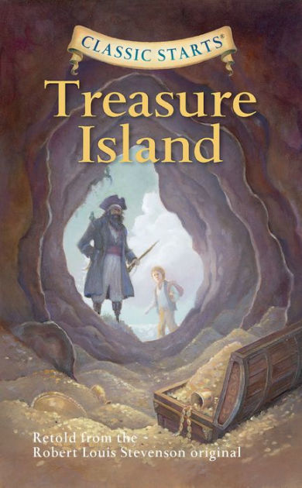
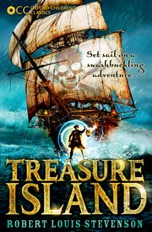
Treasure Island By Robert Louis Stevenson
Class 3 Friday 4th June 2020. Lesson Four

Slide 2
Activity One
Activity One
Using the story map that you have been making, retell the story so far.
You don’t need to recite part one word for word but instead retell it using your won words but try to include some of the relevant vocabulary used in the episode and the language used by the characters
Using the story map that you have been making, retell the story so far.
You don’t need to recite part one word for word but instead retell it using your won words but try to include some of the relevant vocabulary used in the episode and the language used by the characters.
5 minutes

Slide 3
https://www.bbc.co.uk/teach/class-clips-video/english-ks2-treasure-island-pt4/zbb9t39
Activity Two
Activity Two
Watch Part Four: The voyage ant the apple barrel. Note down any interesting or new vocabulary that you hear.
Create a story map for part three. This doesn’t have to be especially detailed (there are ten parts to this story) but should help you to retell the story before we watch the next part in the following lesson.
Watch Part Four: The voyage ant the apple barrel. Note down any interesting or new vocabulary that you hear.
Create a story map for part three. This doesn’t have to be especially detailed (there are ten parts to this story) but should help you to retell the story before we watch the next part in the following lesson.
10 mins including watching the episode.

Slide 4
I will update this page with pupil’s work after the lesson

Slide 5
Activity Three
Activity Three
Complete the VIPERS question sheet based on part four of ‘Treasure Island.’
Re-watch this part as many times as you wish to help you answer the questions.
Remember to write your answers in full sentences and, when suitable, support your answers with details from ‘Treasure Island.’
Complete the VIPERS question sheet based on part four of ‘Treasure Island.’
Re-watch this part as many times as you wish to help you answer the questions.
Remember to write your answers in full sentences and, when suitable, support your answers with details from ‘Treasure Island.’
30-40 minutes

Slide 6
Activity Four:
Activity Four:
This is a very short activity.
On your sheet titled ‘Character Word Bank,’ write at least five adjectives that describe the characters of Jim Hawkins and Long John Silver in part four.
You could use a thesaurus to help you come up with interesting vocabulary that you don’t often use.
This is a very short activity.
On your sheet titled ‘Character Word Bank,’ write at least five adjectives that describe the characters of Jim Hawkins and Long John Silver in part four.
You could use a thesaurus to help you come up with interesting vocabulary that you don’t often use.
5 minutes but no more than 10 minutes if using a thesaurus for support.

Slide 7
I will update this page with some of the pupil’s ideas after the lesson

Slide 8
Activity Five
Activity Five
Today’s is a shorter writing activity to give you time to complete any unfinished work from earlier in the week.
Write a character description for all of the characters met so far in “Treasure Island.” include a relative clause in each description.
There is a video below to help remind you how to write a relative clause.
Today’s is a shorter writing activity to give you time to complete any unfinished work from earlier in the week.
Write a character description for all of the characters met so far in “Treasure Island.” include a relative clause in each description.
There is a video below to help remind you how to write a relative clause.
https://www.bbc.co.uk/bitesize/topics/zwwp8mn/articles/zsrt4qt
15 minutes

Slide 9
I will update this page with pupil’s work after the lesson

