Slide 1
To be able to learn how substances melt or freeze at different temperatures.

Slide 2
States of matter
There are 3 states of matter, can you name them?
S……..
L……..
G…..
What do we know about them?

Slide 3
video
(6) Melting and Freezing | BBC Bitesize | science - YouTube

Slide 4
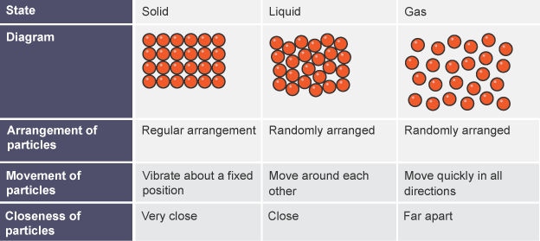
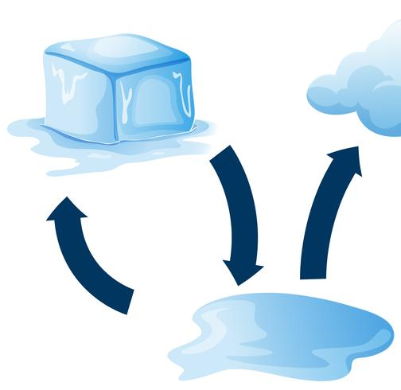
Melting point
If ice (solid) is heated, it changes to water (liquid). This change is called melting.
°C = degrees Celsius
The table summarises what happens to the particles in a substance when it gains energy, and it melts (changes state):
The rough temperature chocolate starts to melt at is 35°C
Ice melts at 0°C turning into a liquid (water)

Slide 5
Change of state
Solids and liquids can be changed from one state to another by heating or cooling.
Heat melts a solid and turns it into a liquid. Cooling freezes a liquid into a solid.
The process of melting and freezing is reversable – you can change them back to their original state
The particles in a substance stay the same when it changes state - only their closeness, arrangement or motion change. This means that the mass of the substance stays the same. For example, 10 g of water boils to form 10 g of steam, or freezes to form 10 g of ice. This is called conservation of mass.

Slide 6
Freezing Point
If water (liquid) is cooled, it changes to ice (solid). This change is called freezing.
The table summarises what happens to the particles in a substance when it loses energy, and it freezes or condenses (ie changes state):
Water freezes at 0°C

Slide 7
Quiz
What are freezing and melting? - BBC Bitesize

Slide 8
Home Experiment on melting:
Find out the different melting point of different chocolate (dark and white)
Put some hot water (no more than 50 c) into a beaker
Put in a thermometer
Take the temperature of the chocolate when not yet melted
Add the chocolate to a different beaker and put that beaker inside the hot water
Stir and take temperature when it starts to melt and when it has fully melted
Record your findings in a table as seen here
Repeat steps 1-6 with white chocolate
Equipment:
Hot beakers x2 (one big and one smaller)
Dark chocolate
White chocolate
Water
Thermometer

Slide 9
Extension:
Questions based on your experiment:
You are going to Spain on holiday and you take some chocolate with you. Considering it’s melting point, which chocolate would you bring and why? Use the findings collected in your experiment
How would you make sure it won’t melt anyway?

Slide 10
Home experiment on freezing:
1. Fill 3 balloons up with water to make small balloons (don’t make them too big, they will have to fit in the freezer!)
2. Freeze the balloons over night
3. Take out the balloons and cut away the balloon from the ice
4. Investigate using your magnifying glass and torch in the dark (are there patterns? What do you notice?)
5. Add cold water to one balloon (time how long it takes to melt)
6. Add hot water to one ice balloon (time how long it takes to melt)
7. Add salt to one ice balloon (time how long it takes to melt)
8. Add food colouring to the salty ice balloon and the melting becomes clearer (what do you notice?)
8. Record your findings in a table
Equipment:
3 balloons
Salt
Water
Freezer
Magnifying glass
Torch
Food colouring (optional)

Slide 11
Extension:
1. Why did the salt melt the ice?
2. What did I notice when I added food colouring to the ice balloons?

