Slide 1
Kensuke’s Kingdom Lesson 4

Slide 2
Front Cover
Look at the front cover. What do you see? What do you notice? Does it give you any clues about the book? Can you predict from the front cover what might happen?

Slide 3
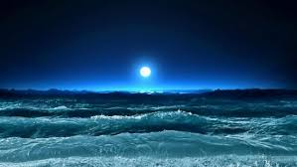
Chapter 4
We are going to read chapter 4 as a class Please jot down any description about the island that you can.

Slide 4
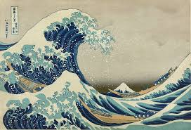
Task
Using the description given to you in the book, I would like you to draw a detailed map/drawing of the island and label it using quotes from the text to support.

