Slide 3
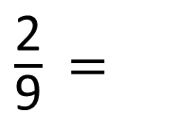
$\frac{\text{2}}{\text{9}}$ =
$\frac{\text{8}}{\text{27}}$
1)
2)
3)
4)
$\frac{\text{7}}{\text{9}}$ $\frac{\text{14}}{\text{18}}$
$\frac{\text{7}}{\text{7}}$ $\text{1}$
$$>$$
$\frac{\text{2}}{\text{19}}$ $\frac{\text{1}}{\text{8}}$

Slide 4
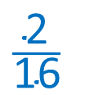
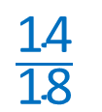
$\frac{\text{2}}{\text{9}}$ =
6
1)
2)
3)
4)
$\frac{\text{8}}{\text{27}}$
$\frac{\text{7}}{\text{9}}$ $\frac{\text{14}}{\text{18}}$
$$=$$
$$\frac{\text{14}}{\text{18}}$$
$$\text{8}$$
$\frac{\text{7}}{\text{7}}$ $\text{1}$
$$\text{Any} \text{integer} \text{greater} \text{than}\text{ 7}$$
$$>$$
$\frac{\text{2}}{\text{19}}$ $\frac{\text{1}}{\text{8}}$
$$\frac{\text{2}}{\text{16}}$$
$$<$$

Slide 6
Write $>, <$ or $=$ to compare the fractions
$\frac{\text{11}}{\text{7}}$ $\frac{\text{9}}{\text{7}}$
$$>$$
Have a think
When the denominators are the same, the greater the numerator, the greater the fraction.

Slide 7

Write $>, <$ or $=$ to compare the fractions
$×$ 2
$\frac{\text{14}}{\text{10}}$
$\frac{\text{7}}{\text{5}}$ $\frac{\text{13}}{\text{10}}$
$$>$$
$×$ 2
When the denominators are the same, the greater the numerator, the greater the fraction.

Slide 8
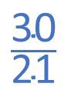
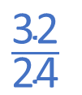
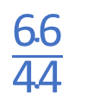
Have a think
Write $>, <$ or $=$ to compare the fractions
$\frac{\text{29}}{\text{24}}$ $\frac{\text{16}}{\text{12}}$
$$\frac{\text{32}}{\text{24}}$$
$$<$$
Greater than double the denominator
$\frac{\text{26}}{\text{21}}$ $\frac{\text{10}}{\text{7}}$
$$\frac{\text{30}}{\text{21}}$$
Less than double the denominator
$$<$$
$$\frac{\text{89}}{\text{44}}$$
$\frac{\text{89}}{\text{44}}$ $\frac{\text{6}}{\text{4}}$
$$\frac{\text{66}}{\text{44}}$$
$$\frac{\text{6}}{\text{4}}$$
$$>$$
2
$$>$$
$$<$$
2

Slide 9
$\frac{\text{15}}{\text{13}}$ $\frac{\text{15}}{\text{10}}$
$$<$$
When the numerators are the same, the greater the denominator, the smaller the fraction.

Slide 10
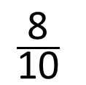

$×$ 3
$\frac{\text{27}}{\text{24}}$ $\frac{\text{9}}{\text{5}}$
$\frac{\text{27}}{\text{15}}$
$$<$$
$×$ 3
When the numerators are the same, the greater the denominator, the smaller the fraction.
Have a think
$$\frac{\text{8}}{\text{7}}$$
$$\frac{\text{4}}{\text{5}}$$
$$>$$
1
$\frac{\text{8}}{\text{7}}$ $\frac{\text{4}}{\text{5}}$
$$<$$
1
$$>$$
$$\frac{\text{8}}{\text{10}}$$

Slide 11
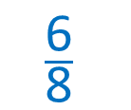
Rosie and Amir both baked some cakes. They got a little hungry and ate part of a cake!
I have $\frac{\text{14}}{\text{5}}$ left.
I have 2 $\frac{\text{3}}{\text{4}}$ cakes left.
I have 2 $\frac{\text{6}}{\text{7}}$ left.
Who has the most cake left?
Amir
2 $\frac{\text{3}}{\text{4}}$ 2 $\frac{\text{6}}{\text{7}}$
$$<$$
$$\frac{\text{6}}{\text{8}}$$
When the numerators are the same, the greater the denominator, the smaller the fraction.
What’s the same about each mixed number?

Slide 12
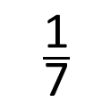
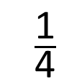
Who has the most cake left?
Amir
2 $\frac{\text{3}}{\text{4}}$ 2 $\frac{\text{6}}{\text{7}}$
$$<$$
What’s the same about each fraction?
$\frac{\text{1}}{\text{4}}$
$$>$$
$\frac{\text{1}}{\text{7}}$
When the numerators are the same, the greater the denominator, the smaller the fraction.

Slide 13
Have a go at questions 1 - 4 on the worksheet

