Slide 1
To be able to tell how liquids boil and evaporate.

Slide 2
States of matter
There are 3 states of matter, can you name them?
S……..
L……..
G…..
What do we know about them?

Slide 3
Video
https://www.youtube.com/watch?v=y5gFI3pMvoI

Slide 4
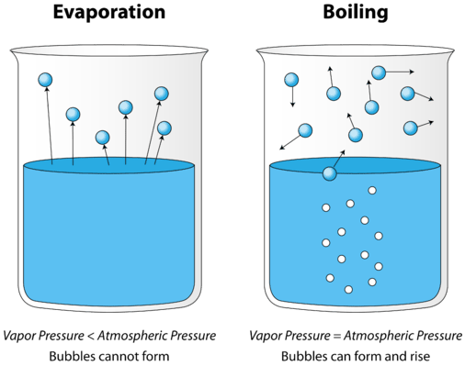
Boiling
When water heats up (to a boiling point), it turns into water vapour. Once water becomes water vapour, it can easily move up to the Earth's atmosphere. Water vapour is a type of gas meaning that the liquid has to turn into a gas to be able to evaporate

Slide 5
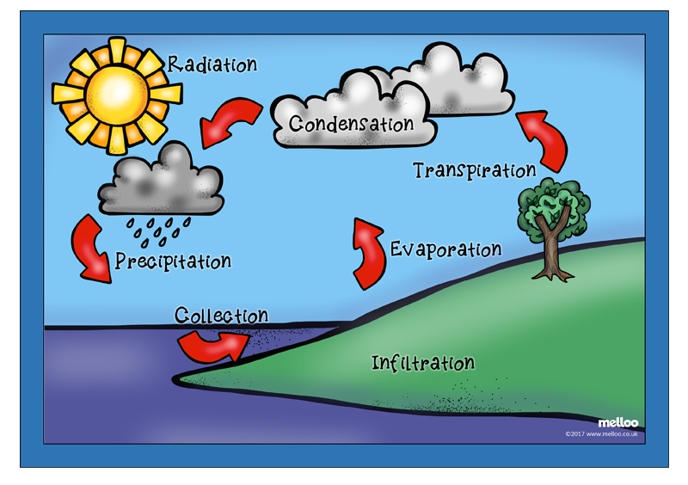
When a liquid becomes a gas it is called boiling or vaporization. Again, at a certain temperature called the boiling point, the molecules will gain enough energy to break free and become a gas. The boiling point for water is 100 degrees C

Slide 6
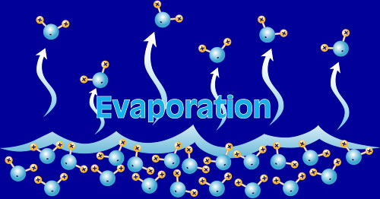
Evaporation is the changing of a liquid into a gas.
Evaporation happens all around us without us knowing it. A puddle on the road which begins to ‘disappear’ is evaporating.
Evaporation happens at a faster rate by the temperature being warmer and by the air moving more quickly in a breeze.

Slide 7
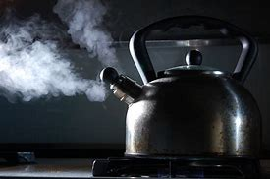
You can see evaporation taking place when a kettle boils, steam is the gas coming from the water. Sometimes you can see steam rising from the road or the playground after it has rained, this too is evaporation.
Other examples of evaporation include warm-air hand driers, blowing on ink to dry it and washing drying well on a sunny breezy day.

Slide 8
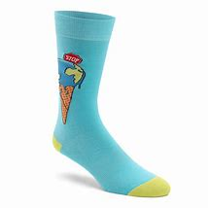
Experiment:
How long it takes for washing to dry in different place? Why is it different?
Make a prediction
Get 3 wet socks and put each one in a different place
On a heater
Outside on a dry day
On a cold surface/cold room
Record how long each sock takes to dry in the table
Write what you notice (compare them with each other) why do you think this?

Slide 9
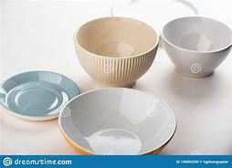
Experiment:
How long it takes for water to evaporate from different containers.
Make a prediction
Take 3 containers (1 small, one medium and one big one)
Put them all on top of a heater/warm place
Fill them with the same amount of water (50ml)
Record your findings (did some water evaporate? Did some not? Why do you think this is?)

Slide 10
Quiz activity

