Slide 3


1) Complete the calculation that is represented:
2)
3) Write your answer in its simplest form:
$$+$$
$\frac{\text{5}}{\text{9}}$ $+$ $\frac{\text{2}}{\text{3}}$ $=$
1$\frac{\text{1}}{\text{2}}$ $+$ 6$\frac{\text{1}}{\text{6}}$

Slide 4

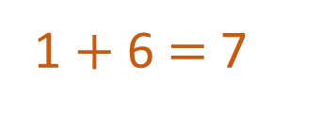

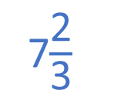
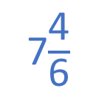



1) Complete the calculation that is represented:
2)
3) Write your answer in its simplest form:
4
$$+$$
2$\frac{\text{1}}{\text{4}}$
1$\frac{\text{3}}{\text{4}}$
$\frac{\text{5}}{\text{9}}$ $+$ $\frac{\text{2}}{\text{3}}$ $=$
$\frac{\text{5}}{\text{9}}$ $+$ $\frac{\text{6}}{\text{9}}$ $=$
$\frac{\text{11}}{\text{9}}$
or 1$\frac{\text{2}}{\text{9}}$
1$\frac{\text{1}}{\text{2}}$ $+$ 6$\frac{\text{1}}{\text{6}}$
1 $+$ 6 $=$ 7
$\frac{\text{3}}{\text{6}}$ $+$ $\frac{\text{1}}{\text{6}}$ $=$ $\frac{\text{4}}{\text{6}}$
7$\frac{\text{4}}{\text{6}}$
7$\frac{\text{2}}{\text{3}}$

Slide 6
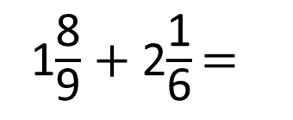
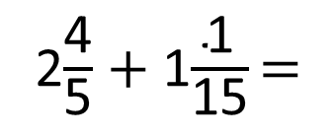
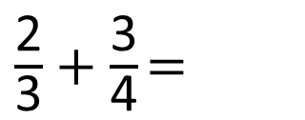
Complete the calculations:
Have a think
$\frac{\text{2}}{\text{3}}$ $+$ $\frac{\text{3}}{\text{4}}$ $=$
2$\frac{\text{4}}{\text{5}}$ $+$ 1$\frac{\text{1}}{\text{15}}$ $=$
1$\frac{\text{8}}{\text{9}}$ $+$ 2$\frac{\text{1}}{\text{6}}$ $=$

Slide 7
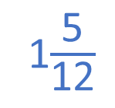

Complete the calculations:
Divide each part into 4
$\frac{\text{2}}{\text{3}}$ $+$ $\frac{\text{3}}{\text{4}}$ $=$
1$\frac{\text{5}}{\text{12}}$
Divide each part into 3
$\frac{\text{2}}{\text{3}}+\frac{\text{3}}{\text{4}}=\frac{\text{8}}{\text{12}}+\frac{\text{9}}{\text{12}}=\frac{\text{17}}{\text{12}}$

Slide 8
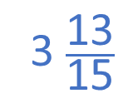
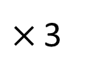
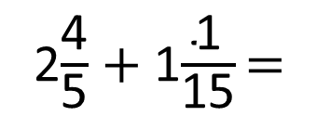
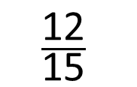
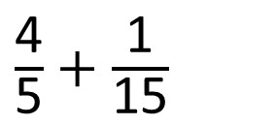
Complete the calculations:
2$\frac{\text{4}}{\text{5}}$ $+$ 1$\frac{\text{1}}{\text{15}}$ $=$
3 $\frac{\text{13}}{\text{15}}$
2 $+$ 1 $=$ 3
$\frac{\text{4}}{\text{5}}$ $+$ $\frac{\text{1}}{\text{15}}$
$×$ 3
$$\frac{\text{12}}{\text{15}}$$
$\frac{\text{12}}{\text{15}}$ $+$ $\frac{\text{1}}{\text{15}}$ $=$ $\frac{\text{13}}{\text{15}}$

Slide 9
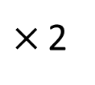
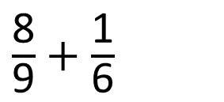
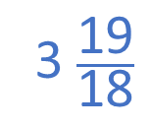
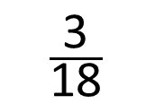
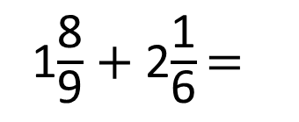

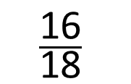
Complete the calculations:
1$\frac{\text{8}}{\text{9}}$ $+$ 2$\frac{\text{1}}{\text{6}}$ $=$
3 $\frac{\text{19}}{\text{18}}$
1 $+$ 2 $=$ 3
$\frac{\text{8}}{\text{9}}$ $+$ $\frac{\text{1}}{\text{6}}$
$×$ 2
$×$ 3
$$\frac{\text{16}}{\text{18}}$$
$$\frac{\text{3}}{\text{18}}$$
Multiples of 9: 9, 18, 27, 36, 45
Multiples of 6: 6, 12, 18, 24, 30

Slide 10
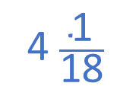
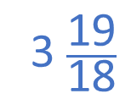
Complete the calculations:
1$\frac{\text{8}}{\text{9}}$ $+$ 2$\frac{\text{1}}{\text{6}}$ $=$
4 $\frac{\text{1}}{\text{18}}$
3 $\frac{\text{19}}{\text{18}}$

Slide 11
Have a go at the questions on the worksheet

Slide 12
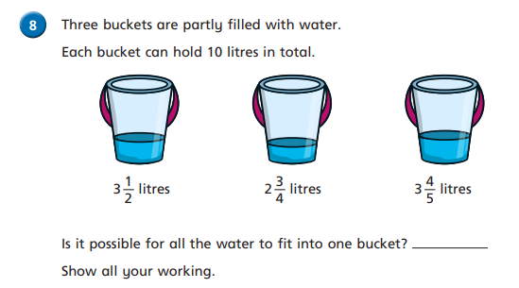
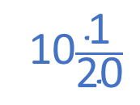
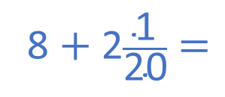
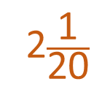
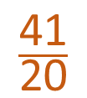
3$\frac{\text{1}}{\text{2}}$ $+$ 2$\frac{\text{3}}{\text{4}}$ $+$ 3$\frac{\text{4}}{\text{5}}$
$\frac{\text{1}}{\text{2}}$ $+$ $\frac{\text{3}}{\text{4}}$ $+$ $\frac{\text{4}}{\text{5}}$
3 $+$ 2 $+$ 3 $=$ 8
8 $+$ 2$\frac{\text{1}}{\text{20}}$ $=$
$\frac{\text{10}}{\text{20}}$ $+$ $\frac{\text{15}}{\text{20}}$ $+$ $\frac{\text{16}}{\text{20}}$
1$\text{0}\frac{\text{1}}{\text{20}}$
$$\frac{\text{41}}{\text{20}}$$
Multiples of 4: 4, 8, 12, 16, 20
2$\frac{\text{1}}{\text{20}}$
Multiples of 5: 5, 10, 15, 20, 25

Slide 13
3$\frac{\text{1}}{\text{2}}$ $+$ 2$\frac{\text{3}}{\text{4}}$ $+$ 3$\frac{\text{4}}{\text{5}}$
$\frac{\text{1}}{\text{2}}$ $+$ $\frac{\text{3}}{\text{4}}$ $+$ $\frac{\text{4}}{\text{5}}$ has to be less than 2
3 $+$ 2 $+$ 3 $=$ 8
$\frac{\text{1}}{\text{2}}$ $+$ $\frac{\text{3}}{\text{4}}$ $=$ 1$\frac{\text{1}}{\text{4}}$
$\frac{\text{4}}{\text{5}}$ $\frac{\text{3}}{\text{4}}$
$\frac{\text{1}}{\text{2}}$ $+$ $\frac{\text{3}}{\text{4}}$ $+$ $\frac{\text{4}}{\text{5}}$ $>$2
$$>$$

Slide 14
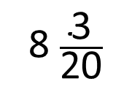
1
2
3
4
5
6
8 $\frac{\text{3}}{\text{20}}$
1 and 20
20
4 and 5
2 and 10
1, 2, 4, 5

Slide 15
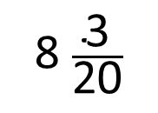
1
2
3
4
5
6
$$+$$
8 $\frac{\text{3}}{\text{20}}$

Slide 16
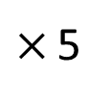
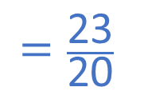
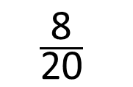
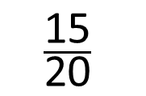
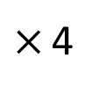
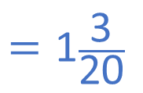
1
2
3
4
5
6
$$+$$
8 $\frac{\text{3}}{\text{20}}$
$×$ 5
$×$ 4
$$\frac{\text{15}}{\text{20}}$$
$$+$$
$$\frac{\text{8}}{\text{20}}$$
$$=\frac{\text{23}}{\text{20}}$$
$$=\text{1}\frac{\text{3}}{\text{20}}$$
6 $+$ 1 $=$ 7

