Slide 1
I am learning about fronted adverbials and conjunctions.

Slide 2
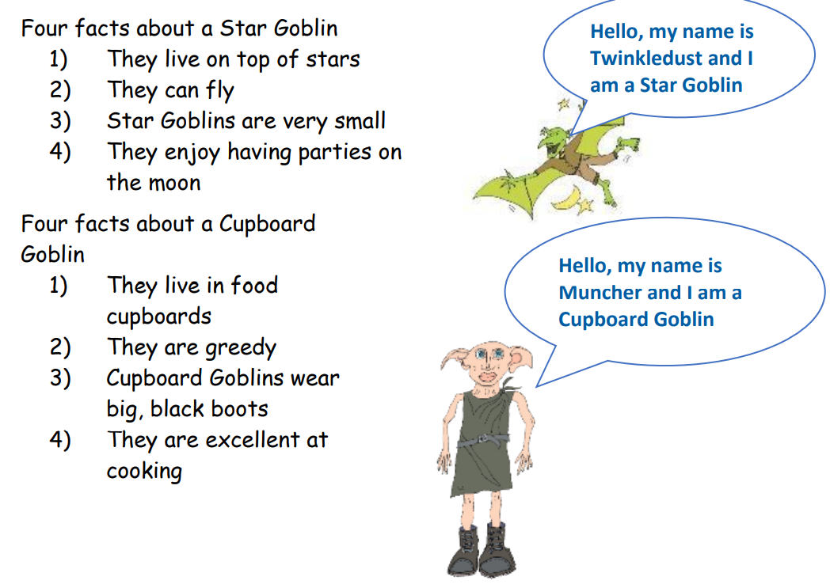
Different types of Goblins

Slide 3
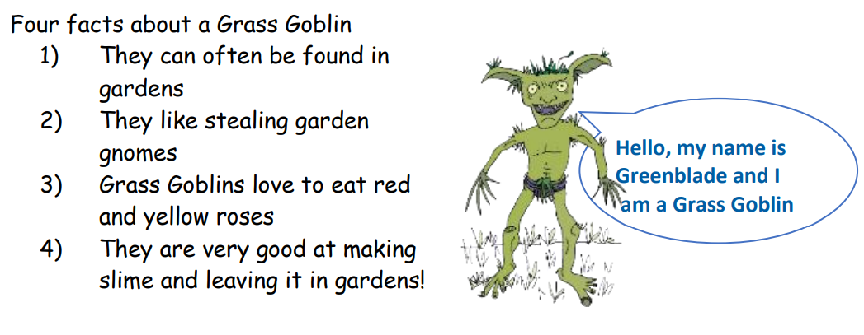
Different types of Goblins

Slide 4
Unsurprisingly, the vast majority of Grass Goblins can be found in gardens because they love to eat red and yellow roses. Interestingly, most Grass Goblins like stealing garden gnomes and leaving behind their slime.

Slide 5
Unsurprisingly, the vast majority of Grass Goblins can be found in gardens because they love to eat red and yellow roses. Interestingly, most Grass Goblins like stealing garden gnomes and leaving behind their slime.

Slide 6
I have: ★ started the sentences with some engaging adverbs ★ joined two facts together showing how one led to the other by using ‘because’ ★ joined two facts together using ‘and’ ★ Used words like, ‘the majority’ and ‘most’ to generalise about these goblins ★ used the present tense (love/like).

Slide 7
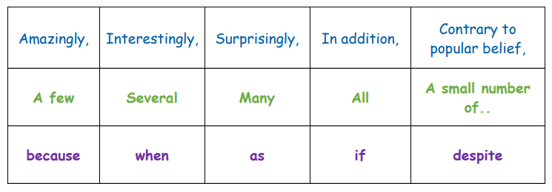
Here is a word bank with some useful words.
Adverbial starters –
Generalising words –
Conjunctions –

Slide 8
Here is a word bank with some useful words.

Slide 9
Use the words from the word table to join the Cupboard Goblin facts together.

