Slide 3
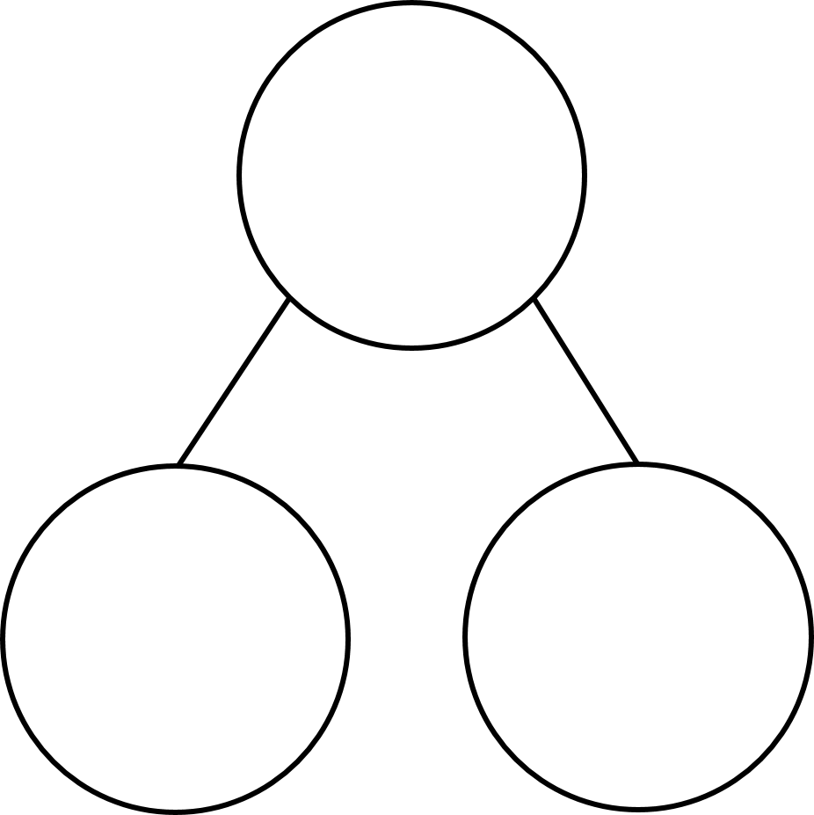


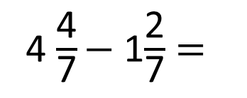


$\frac{\text{3}}{\text{5}}$ $+$ $\frac{\text{2}}{\text{3}}$ $=$
1)
2)
3) Complete the part-whole models:
4 $\frac{\text{4}}{\text{7}}$ $−$ 1$\frac{\text{2}}{\text{7}}$ $=$
1 $\frac{\text{7}}{\text{9}}$
1
$$\frac{\text{7}}{\text{11}}$$
$$\frac{\text{2}}{\text{3}}$$

Slide 4



$\frac{\text{3}}{\text{5}}$ $+$ $\frac{\text{2}}{\text{3}}$ $=$
$\frac{\text{9}}{\text{15}}$ $+$ $\frac{\text{10}}{\text{15}}$ $=$
$\frac{\text{19}}{\text{15}}$
or 1 $\frac{\text{4}}{\text{15}}$
1)
2)
3) Complete the part-whole models:
4 $\frac{\text{4}}{\text{7}}$ $−$ 1$\frac{\text{2}}{\text{7}}$ $=$
$\frac{\text{2}}{\text{7}}$
3
$$\frac{\text{11}}{\text{11}}$$
1 $\frac{\text{7}}{\text{9}}$
1
$$\frac{\text{7}}{\text{11}}$$
$$\frac{\text{4}}{\text{11}}$$
$$\frac{\text{6}}{\text{9}}$$
$\frac{\text{1}}{\text{9}}$
$$\frac{\text{2}}{\text{3}}$$
1

Slide 6
Have a think
I have $\text{1}\frac{\text{1}}{\text{2}}$ kg of flour.
I use $\frac{\text{5}}{\text{8}}$ kg of flour to make a cake.
How much flour is left?
$$\frac{\text{1}}{\text{2}} \text{kg}$$

Slide 7
I have $\text{1}\frac{\text{1}}{\text{2}}$ kg of flour.
I use $\frac{\text{5}}{\text{8}}$ kg of flour to make a cake.
How much flour is left?
$\frac{\text{4}}{\text{8}}$
1$\frac{\text{4}}{\text{8}}$
$\frac{\text{1}}{\text{2}}$
$\frac{\text{7}}{\text{8}}$
1$\frac{\text{1}}{\text{2}}$
0
1
$×$4
$−\frac{\text{1}}{\text{8}}$
$−\frac{\text{4}}{\text{8}}$
$$\frac{\text{1}}{\text{2}} =$$
$$\frac{\text{10}}{\text{8}}$$
$$\frac{\text{4}}{\text{8}}$$
1 $\frac{\text{4}}{\text{8}}−\frac{\text{4}}{\text{8}}=$ 1
1$=\frac{\text{8}}{\text{8}}$
$×$4
$\frac{\text{8}}{\text{8}}−\frac{\text{1}}{\text{8}}=$ $\frac{\text{7}}{\text{8}}$ kg

Slide 8
I have $\text{1}\frac{\text{1}}{\text{2}}$ kg of flour.
I use $\frac{\text{5}}{\text{8}}$ kg of flour to make a cake.
How much flour is left?
$$\frac{\text{1}}{\text{2}}$$
1
$$− \frac{\text{5}}{\text{8}}$$
$$− \frac{\text{5}}{\text{8}}$$
1 $\frac{\text{4}}{\text{8}}−\frac{\text{4}}{\text{8}}=$ 1
1$=\frac{\text{8}}{\text{8}}$
$$\frac{\text{3}}{\text{8}}$$
$$\frac{\text{4}}{\text{8}}$$
$=$ $\frac{\text{7}}{\text{8}}$ kg
$$+$$
$\frac{\text{8}}{\text{8}}−\frac{\text{1}}{\text{8}}=$ $\frac{\text{7}}{\text{8}}$

Slide 9
$$− \frac{\text{7}}{\text{8}}$$
$$\frac{\text{5}}{\text{16}}$$
1
Have a think
$$− \frac{\text{14}}{\text{16}}$$
$×$2
$$\frac{\text{5}}{\text{16}}$$
$$\frac{\text{7}}{\text{8}} =$$
$$\frac{\text{10}}{\text{16}}$$
$$\frac{\text{2}}{\text{16}}$$
$$\frac{\text{14}}{\text{16}}$$
$$+$$
$=\frac{\text{7}}{\text{16}}$
$×$2

Slide 10
Have a go at questions 1 - 3 on the worksheet

Slide 11
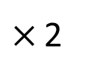
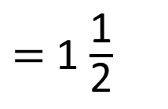

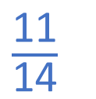
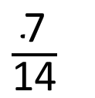
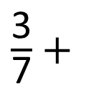
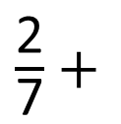
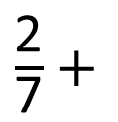
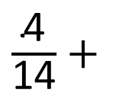
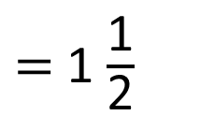
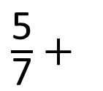
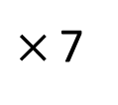
$\frac{\text{2}}{\text{7}}$ $+$
$\frac{\text{3}}{\text{7}}$ $+$
$\frac{\text{11}}{\text{14}}$
$=$ 1 $\frac{\text{1}}{\text{2}}$
Have a think
$\frac{\text{5}}{\text{7}}$ $+$
$=$ 1 $\frac{\text{1}}{\text{2}}$
$\frac{\text{2}}{\text{7}}$ $+$
$\frac{\text{1}}{\text{2}}$
$×$ 2
$×$ 7
$\frac{\text{4}}{\text{14}}$ $+$
$\frac{\text{7}}{\text{14}}$

Slide 12
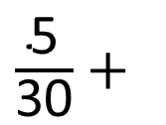

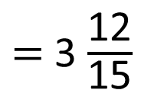
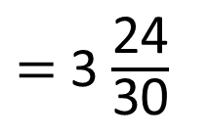
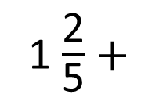
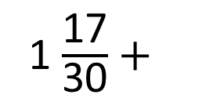
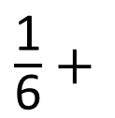
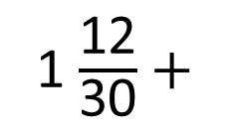
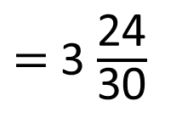
$\frac{\text{1}}{\text{6}}$ $+$
1 $\frac{\text{2}}{\text{5}}$ $+$
$=$ 3 $\frac{\text{12}}{\text{15}}$
$\frac{\text{5}}{\text{30}}$ $+$
1 $\frac{\text{12}}{\text{30}}$ $+$
$=$ 3 $\frac{\text{24}}{\text{30}}$
1 $\frac{\text{17}}{\text{30}}$ $+$
$\frac{\text{7}}{\text{30}}$
$=$ 3 $\frac{\text{24}}{\text{30}}$
2
Multiples of 6: 6, 12, 18, 24, 30, 36
Multiples of 5: 5, 10, 15, 20, 25, 30
Multiples of 15: 15, 30, 45, 60, 75, 90

Slide 13
Rosie has 1 litre of orange juice.
She gives Eva $\frac{\text{1}}{\text{4}}$ litre and Dexter gets $\frac{\text{2}}{\text{5}}$ litre.
Mo has 1 litre of apple juice.
He gives Jack $\frac{\text{1}}{\text{5}}$ litre and Amir gets $\frac{\text{1}}{\text{2}}$ litre.
Who has the most juice left?
Have a think

Slide 14
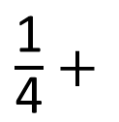
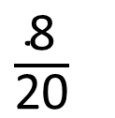
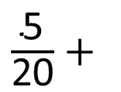

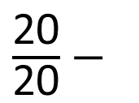
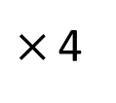
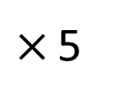

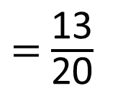
Rosie has 1 litre of orange juice.
She gives Eva $\frac{\text{1}}{\text{4}}$ litre and Dexter gets $\frac{\text{2}}{\text{5}}$ litre.
$\frac{\text{1}}{\text{4}}$ $+$
$\frac{\text{2}}{\text{5}}$
$×$ 5
$×$ 4
$\frac{\text{5}}{\text{20}}$ $+$
$\frac{\text{8}}{\text{20}}$
$=$ $\frac{\text{13}}{\text{20}}$
$\frac{\text{20}}{\text{20}}$ $−$
$\frac{\text{13}}{\text{20}}$
Rosie has $\frac{\text{7}}{\text{20}}$ litre left

Slide 15
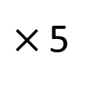
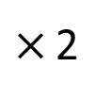


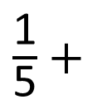
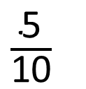
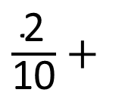
Mo has 1 litre of apple juice.
He gives Jack $\frac{\text{1}}{\text{5}}$ litre and Amir gets $\frac{\text{1}}{\text{2}}$ litre.
$\frac{\text{1}}{\text{5}}$ $+$
$\frac{\text{1}}{\text{2}}$
$×$ 2
$×$ 5
$\frac{\text{2}}{\text{10}}$ $+$
$\frac{\text{5}}{\text{10}}$
$=$ $\frac{\text{7}}{\text{10}}$
Mo has $\frac{\text{3}}{\text{10}}$ litre left

Slide 16
Rosie has 1 litre of orange juice.
She gives Eva $\frac{\text{1}}{\text{4}}$ litre and Dexter gets $\frac{\text{2}}{\text{5}}$ litre.
Mo has 1 litre of apple juice.
He gives Jack $\frac{\text{1}}{\text{5}}$ litre and Amir gets $\frac{\text{1}}{\text{2}}$ litre.
Rosie has $\frac{\text{7}}{\text{20}}$ litre left
Mo has $\frac{\text{6}}{\text{20}}$ litre left
Mo has $\frac{\text{3}}{\text{10}}$ litre left
Who has the most juice left?

Slide 17
Have a go at the rest of the questions on the worksheet

