Slide 2
Diving into Mastery Guidance for Educators
Each activity sheet is split into three sections, diving, deeper and deepest, which are represented by the following icons:
These carefully designed activities take your children through a learning journey, initially ensuring they are fluent with the key concept being taught; then applying this to a range of reasoning and problem-solving activities.
These sheets might not necessarily be used in a linear way. Some children might begin at the ‘Deeper’ section and in fact, others may ‘dive straight in’ to the ‘Deepest’ section if they have already mastered the skill and are applying this to show their depth of understanding.
Diving
Deeper
Deepest

Slide 3
Aim
Multiply proper fractions and mixed numbers by whole numbers, supported by materials and diagrams.

Slide 4
Multiply Unit Fractions by an Integer
Diving
Match each calculation to the correct model that represents it and then complete the calculations.
1
1
1
1
1
1
4
6
6
6
6
6
4 × =
5
5
0
1
1
5
5 × =
6
6
1 fifth
1
3
1 fifth
× 3 =
8
8
1 fifth
1 fifth
1
3
× 3 =
4
4

Slide 5
Multiply Unit Fractions by an Integer
Diving
Complete these calculations. You could draw one of the models similar to the ones on the previous slide to help.
Simplify your answers where possible.
1
4
= 1
4 × =
4
4
1
× 5 =
5
8
8
1
7
=
1
7 × =
14
14
2
1
3
1
× 9 =
9
=1
=1
6
6
6
2

Slide 6
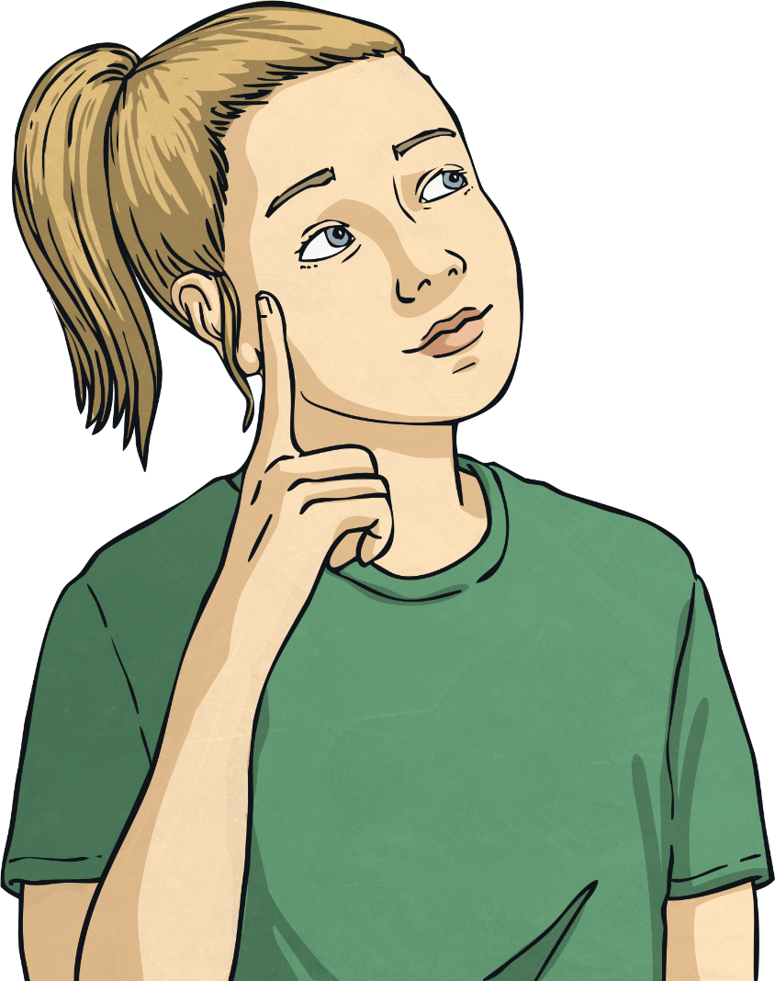
Multiply Unit Fractions by an Integer
Deeper
True or false? Prove it!
Simplify fractions where possible.
a
1
× 4 = 8 ×
1
True
4
=
8
=
4
5
10
5
10
5
b
1
1
False
3
<
7
× 3 > × 7
4
8
4
8
c
1
1
False
5
<
7
= 1
1
× 5 = × 7
7
6
7
6
6
d
1
× 4 < 10 ×
1
True
4
<
10
=
5
6
12
6
12
6

Slide 7
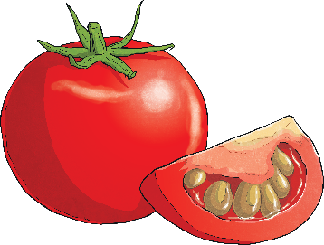
Multiply Unit Fractions by an Integer
Deeper
1
Jez is having a pizza party for his birthday. He needs of a pack of tomatoes for each pizza. Jez is making 6 pizzas. How many packs of tomatoes will he need?
3
1
6
× 6 =
= 2
3
3
Jez will need 2 packs of tomatoes.

Slide 8
Multiply Unit Fractions by an Integer
Deepest
Find 3 possible solutions to complete the calculation.
1
× = 1
4
1
5
1
× = 1
4
4
1
7
3
× = 1
4
4
1
10
10
2
10
× = =1 =1
4
8
8
4

Slide 9
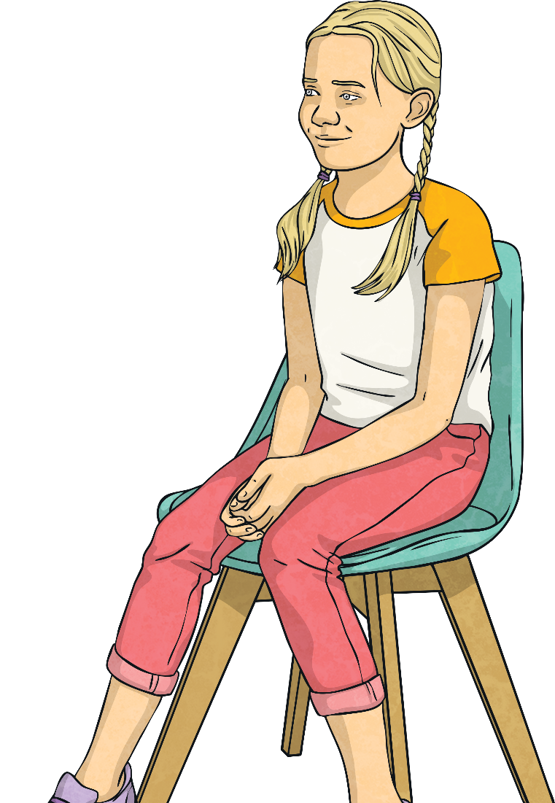
Multiply Unit Fractions by an Integer
Deepest
Jessie multiplies a unit fraction by an integer.
The fraction has a denominator which is a factor of 8.
The product is less than 1.
The integer is a factor of 10.
What could the calculation be?
There are 3 possible answers. Can you find them all?
1
1
× 1 =
2
2
1
2
1
× 2 = =
4
4
4
1
5
× 5 =
8
8

Slide 10
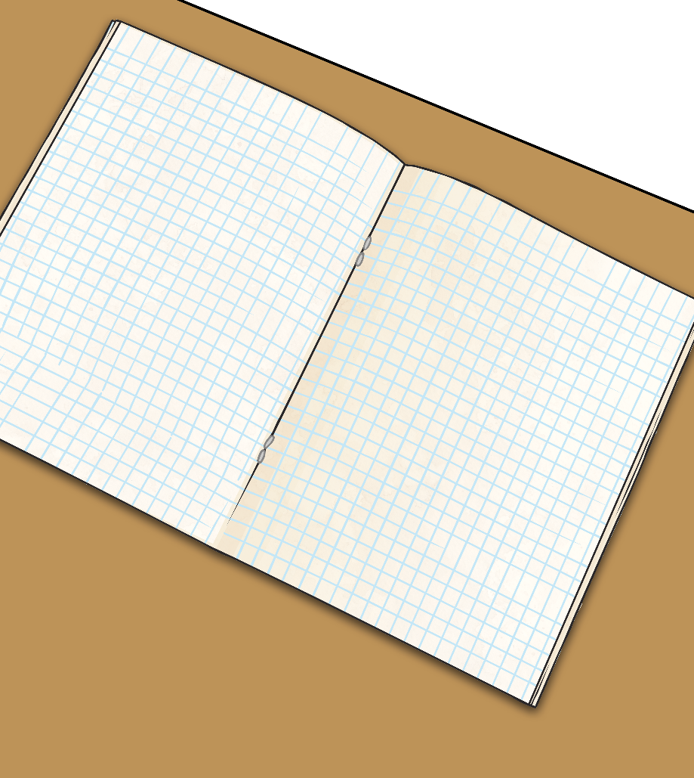
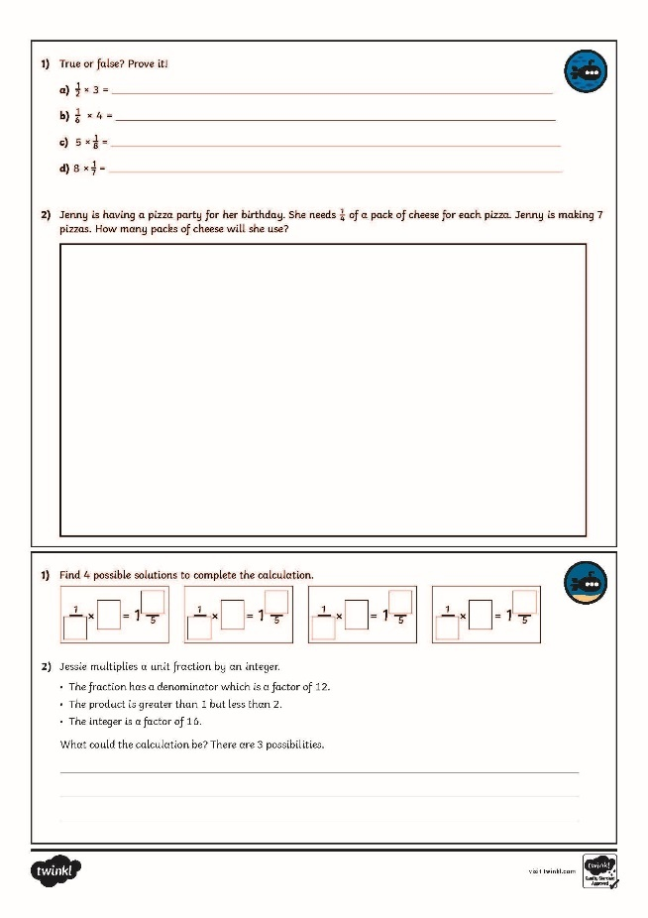
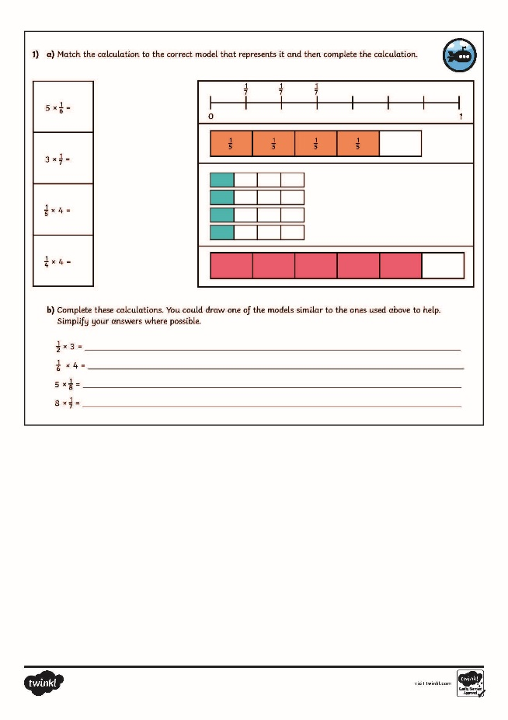
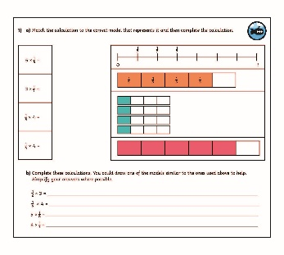
Multiply Unit Fractions by an Integer
Dive in by completing your own activity!

Slide 11
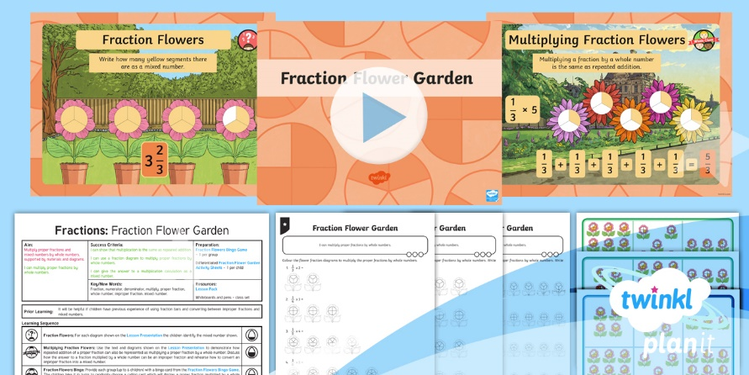
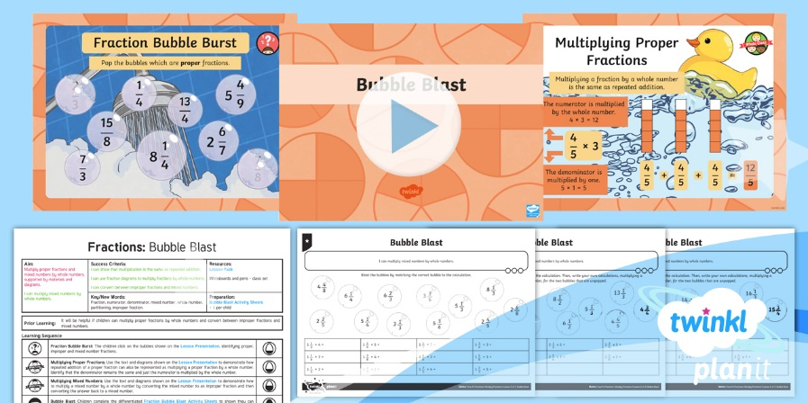
Need Planning to Complement this Resource?
National Curriculum Aim
Multiply proper fractions and mixed numbers by whole numbers, supported by materials and diagrams.
For more planning resources to support this aim, click here.
Twinkl PlanIt is our award-winning scheme of work with over 4000 resources.

